Slide 1
Pneumonia Detection in Chest X-ray Images Using a Hybrid Model of Shallow CNN and VGG16 Transfer Learning
B.Sc. Final-Defense
Md. Rubel Mian
ID: 221-15-5379
And
Md. Akmal Hossain Razu
ID: 221-15-5516
Department : CSE
Daffodil International University

Slide 2
Outline
Introduction
Objective
Background Study
Gap Analysis
Methodology
Results & Analysis
Novelty of the Work
Sample Dataset & Expected Output
Web Interface
Conclusion
References
B.Sc. Final-Defense

Slide 3
Introduction
Pneumonia is a life-threatening respiratory infection.
Early and accurate detection can save lives, especially for children and elderly.
Chest X-ray is the most accessible imaging for diagnosis but interpretation suffers from human subjectivity and time constraints.
Deep learning can automate and improve diagnostic accuracy.
B.Sc. Final-Defense

Slide 4
Objective
Leveraging deep learning for better X-ray analysis.
Improving performance, generalizability and robustness by using an ensemble (hybrid) approach.
Leveraging explainable AI (XAI) to achieve better interpretability and transparency in model's decision-making process.
B.Sc. Final-Defense

Slide 5
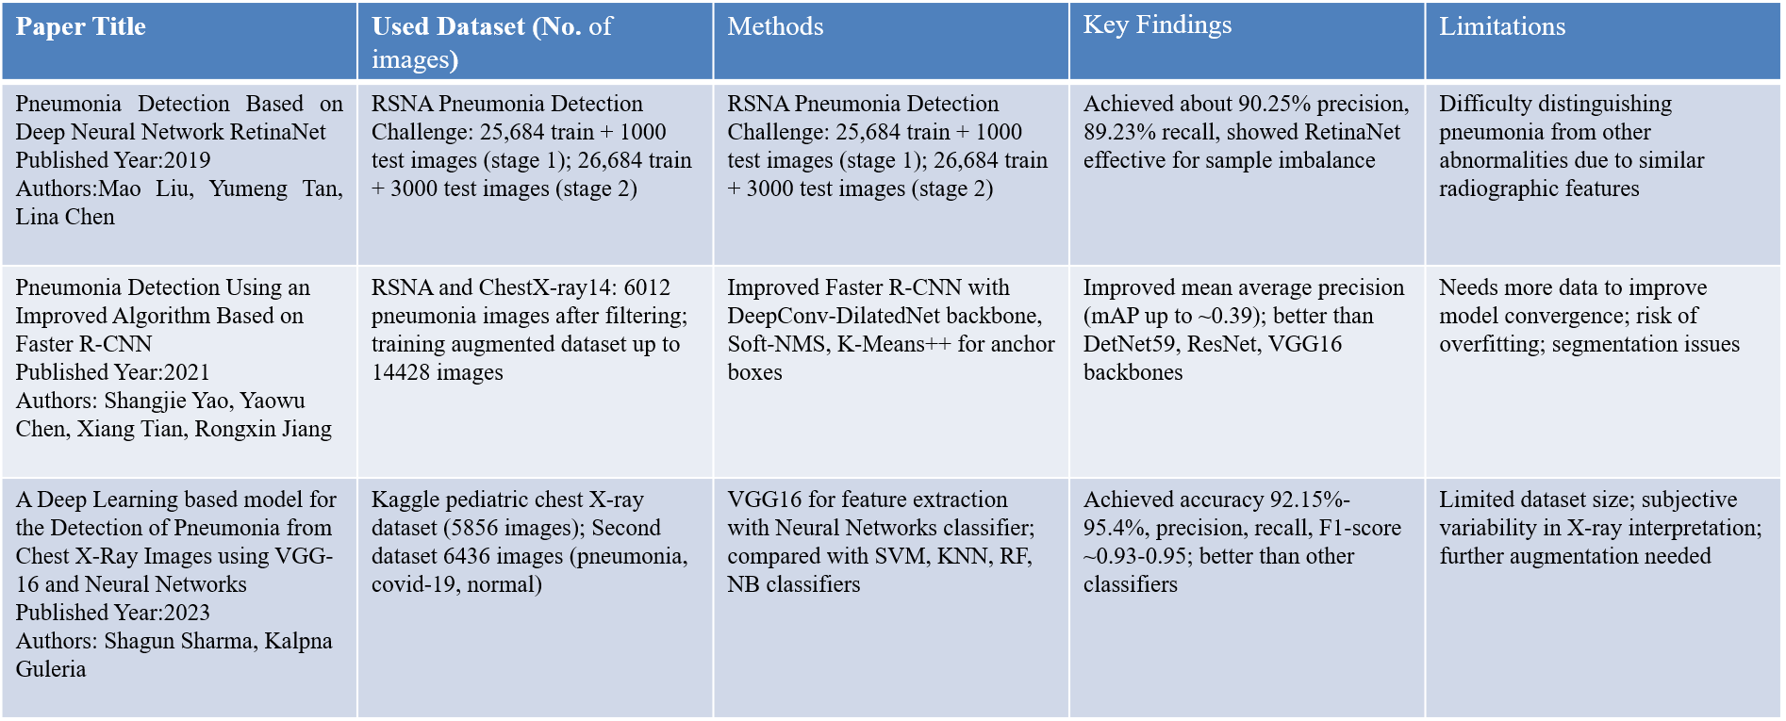
Background Study
B.Sc. Final-Defense

Slide 6
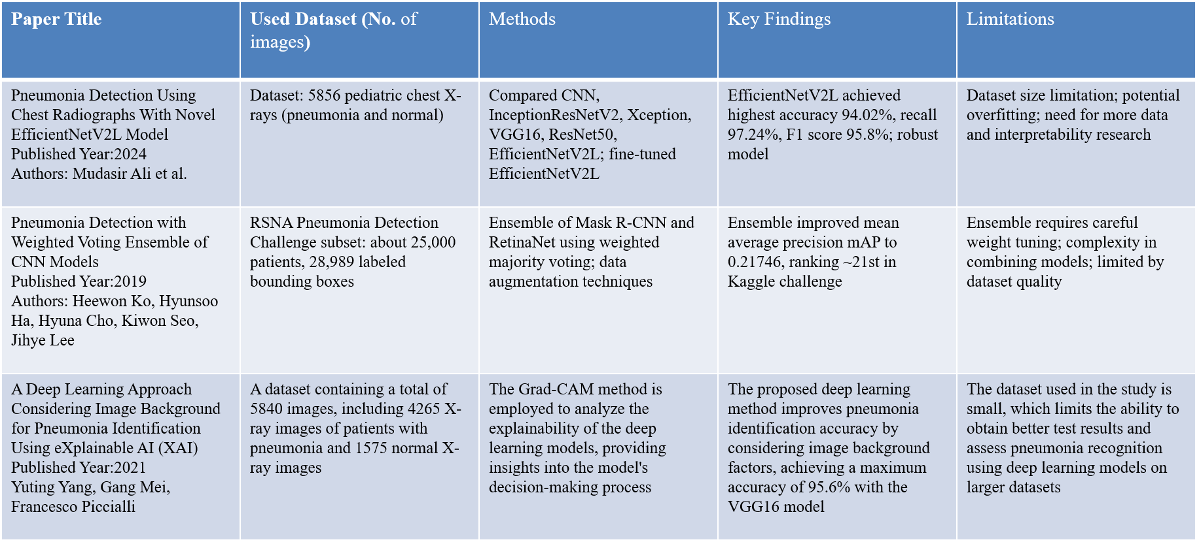
Background Study
B.Sc. Final-Defense

Slide 7
Gap Analysis
High Computational Cost:
Deep learning models like VGG16 require significant resources, making them impractical for resource-limited settings. The hybrid Shallow CNN + VGG16 model balances accuracy and efficiency for real-time use.
Dataset Imbalance:
Existing models struggle with unbalanced datasets, but the hybrid model improves detection reliability in diverse conditions.
Lack of Explainability:
Traditional models lack transparency. The hybrid model incorporates explainable AI (XAI) techniques like LIME and SHAP for clearer, more trustworthy predictions.
B.Sc. Final-Defense

Slide 8







Methodology: Workflow Diagram
Data-Collection(X-ray Images from Kaggle)
Grad-CAM Visualization(Generate Heatmap)
VGG16 Architecture(Freeze Pre-trained Layers)
Train VGG16
Evaluate VGG16
Model Evaluation
LIME Explanation (Generate LIME Super-pixel)
Normalization(Grayscale to RGB for VGG16
Shallow CNN Architecture (Dropout/regularization)
Train Shallow CNN
Evaluate Shallow CNN
Explainability Methods
Soft Voting
Hybrid Ensemble
Evaluate Ensemble
SHAP Explanation(Generate SHAP Heatmap)
Data Augmentation ( Rotation, Zoom )
Confusion Matrix
Train-Test Split
Model Training and Evaluation
Accuracy, Precision, Recall, F1-Score
Data Preprocessing
Model Selection (Ensemble)
Performance Comparison
Final Model Deployment
ROC Curve & AUC
B.Sc. Final-Defense

Slide 9
Result and Analysis
Evaluation Methodology:
Experiment:
The models (CNN, VGG16 Transfer Learning, and Ensemble) were trained and evaluated on the pneumonia detection dataset.
Case Study:
The case study focused on detecting pneumonia from chest X-rays using a hybrid model combining Shallow CNN and VGG16, along with explainability techniques (LIME, SHAP, Grad-CAM).
Software Verification and Validation:
Model verification was performed by comparing predictions from CNN, VGG16, and the hybrid model (ensemble of CNN and VGG16). Validation included metrics like AUC, accuracy, and confusion matrices and visualizing prediction explainability using Grad-CAM, SHAP, and LIME.
B.Sc. Final-Defense

Slide 10
Result and Analysis
Study Case Design:
Data Collection
Data Preprocessing
Model Training & Evaluation
Explainability Methods
Model Evaluation
Deployment
Model Selection
Performance Comparison
B.Sc. Final-Defense

Slide 11
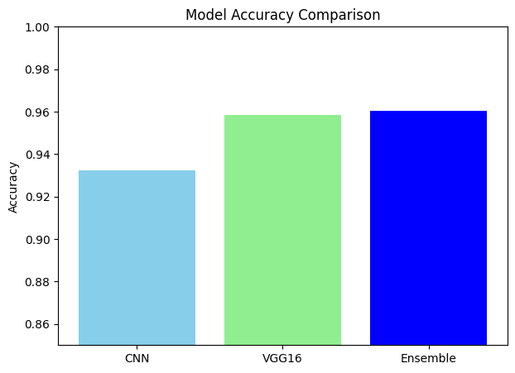
Result and Analysis
Output of Model:
Model | Accuracy
Shallow CNN | 0.9321382842509603
VGG16 Transfer Learning | 0.9586000853606488
Hybrid Model (Ensemble of Shallow CNN & VGG16 TL) | 0.9603072983354674
Figure: Bar Chart of Model Accuracy
B.Sc. Final-Defense

Slide 12
Novelty of the Work
Hybrid Deep Learning Model: The integration of a Shallow CNN with VGG16 transfer learning to form a hybrid model for pneumonia detection is an innovative approach that combines low-level feature extraction (from CNN) with high-level semantic understanding (from VGG16), offering both accuracy and computational efficiency.
Optimized for Resource-Limited Environments: Unlike traditional deep learning models, which require extensive computational resources, the proposed hybrid model is designed to work effectively in low-resource settings (e.g., rural hospitals), making it suitable for real-world deployment without the need for expensive hardware.
Explainable AI Integration: The novel use of Explainable AI (XAI) techniques like SHAP, LIME, and Grad-CAM ensures that the model's decisions are transparent and interpretable. This is crucial for clinical adoption, where trust and understanding of AI-based decisions are paramount.
B.Sc. Final-Defense

Slide 13
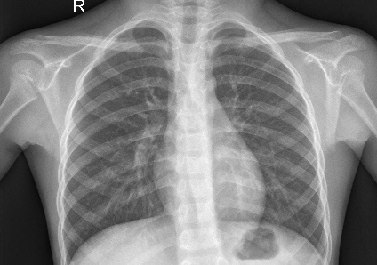
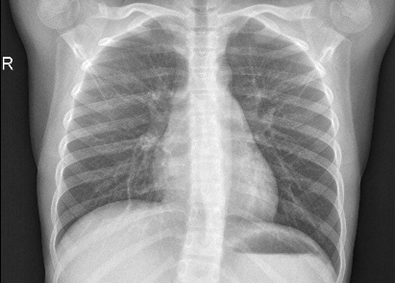
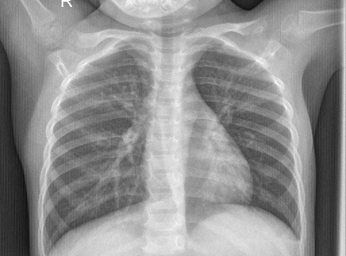
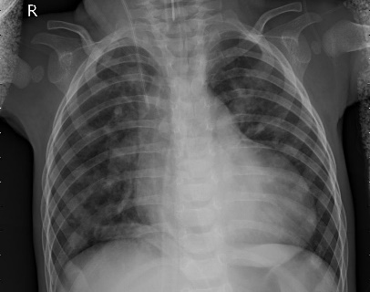
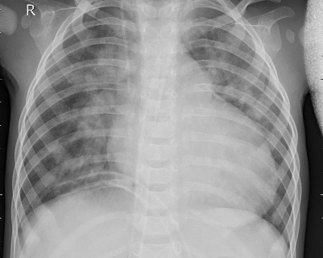
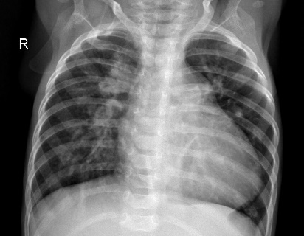
Sample dataset
X-Ray: Normal
X-Ray: Pneumonia
B.Sc. Final-Defense

Slide 14
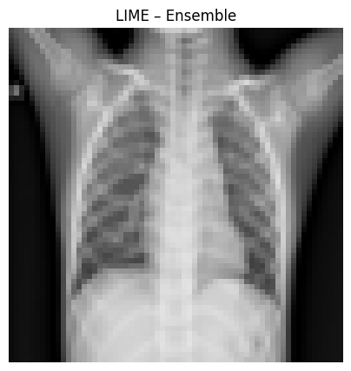
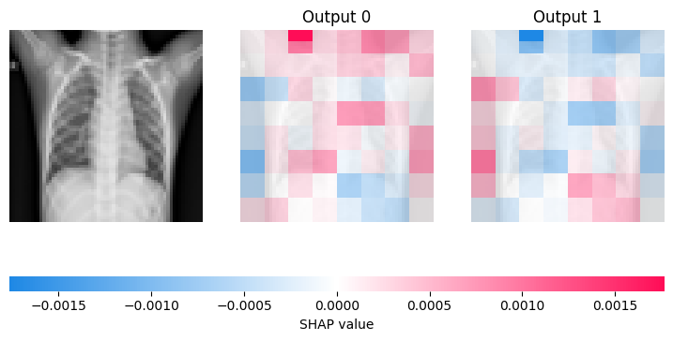
Expected Output
Explainability Visualizations:
Figure: LIME Output
Figure: SHAP Output
B.Sc. Final-Defense

Slide 15
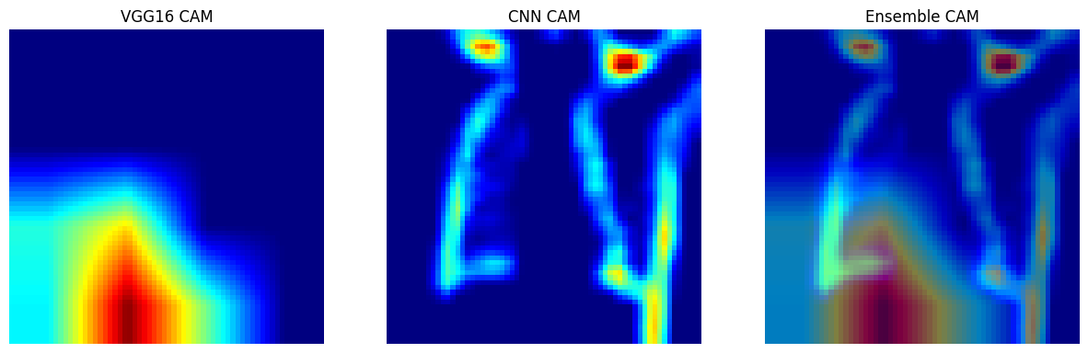
Sample dataset
Explainability Visualizations:
Figure: Grad-CAM output
B.Sc. Final-Defense

Slide 16
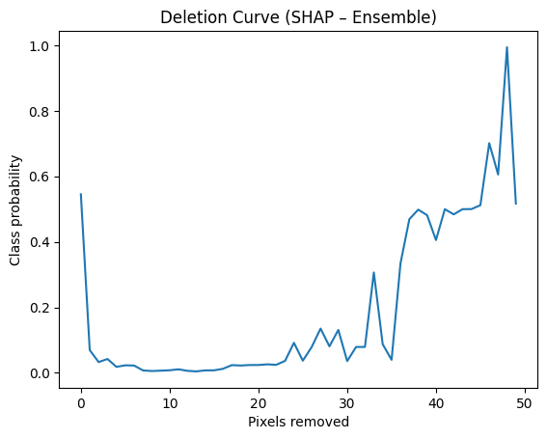
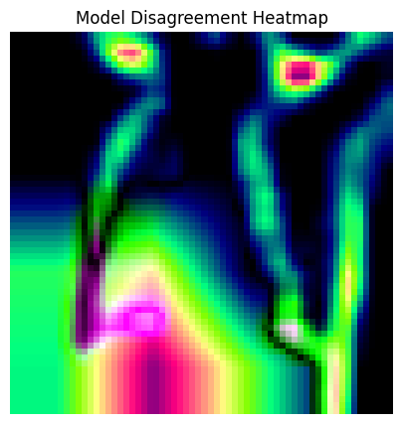
Expected Output
Figure: Deletion Curve
Figure: Disagreement Heatmap
AUC = 9.157678
B.Sc. Final-Defense

Slide 17
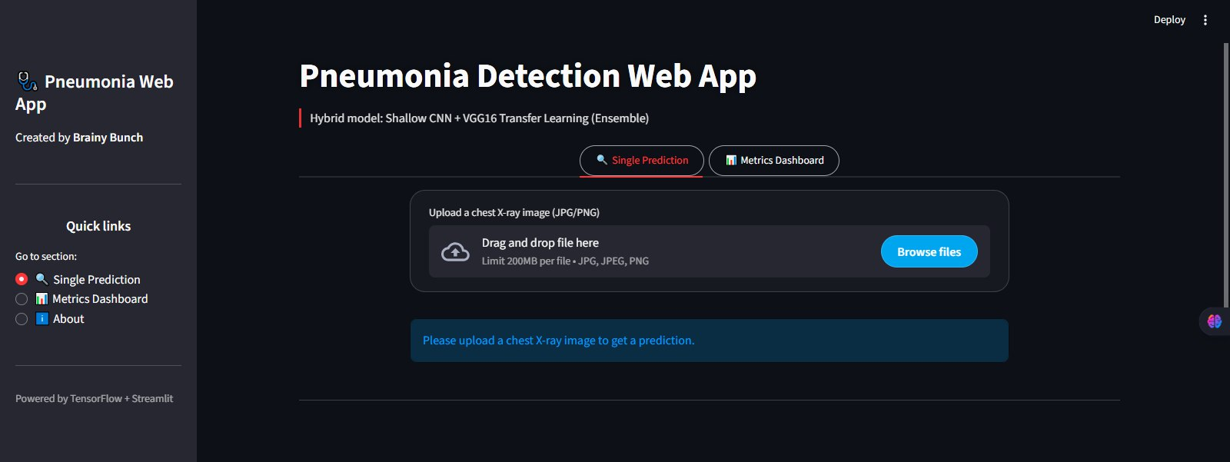
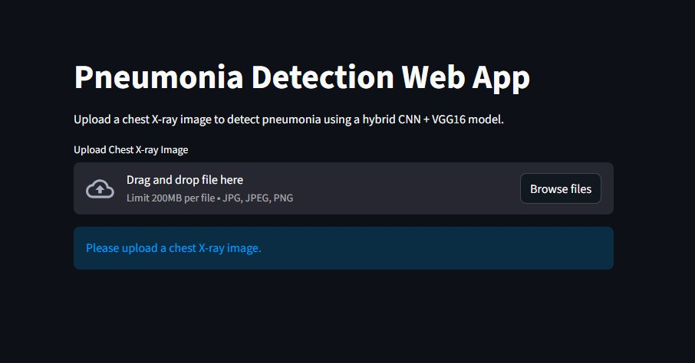
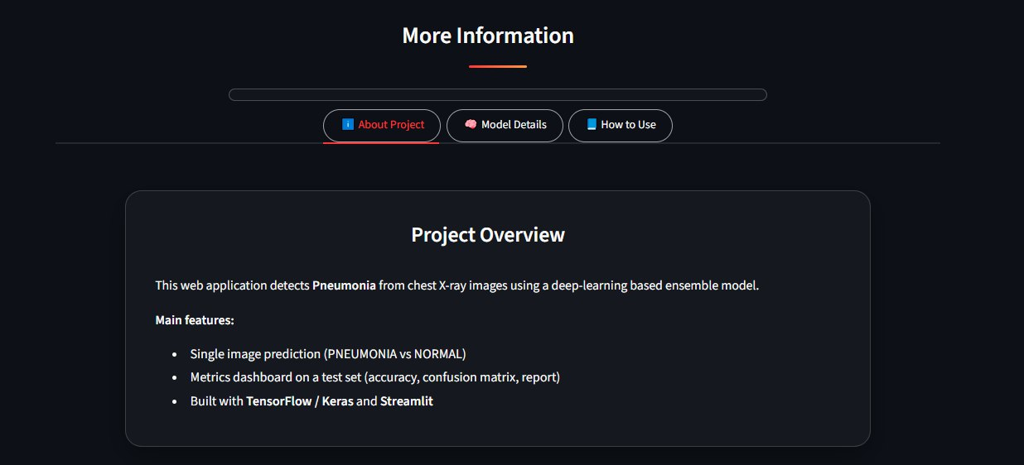
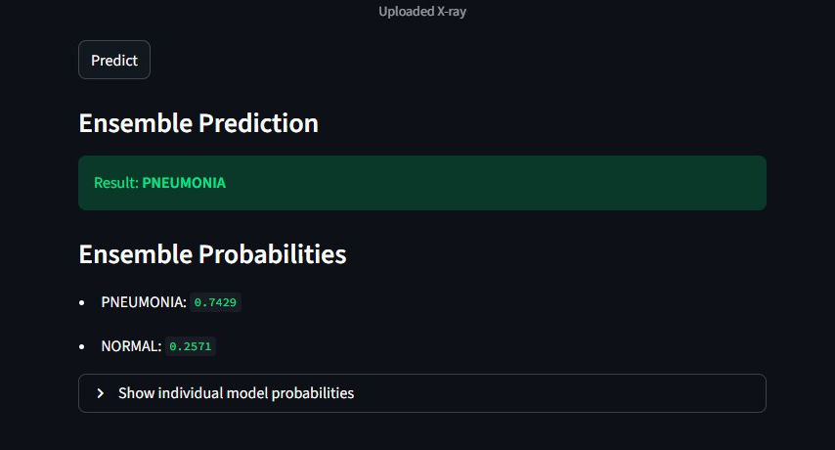
Web Interface of Image Enhancement
B.Sc. Final-Defense

Slide 18
Conclusion
Objective Achieved:
The project successfully developed a hybrid deep learning model combining Shallow CNN and VGG16 transfer learning for accurate pneumonia detection from chest X-ray images. This model demonstrated high accuracy (96%) and was optimized for use in resource-limited clinical settings.
Key Contributions:
The hybrid model outperformed individual CNN and VGG16 models in terms of both accuracy and computational efficiency.
The integration of explainable AI (XAI) methods, including SHAP, LIME, and Grad-CAM, enhanced the model's transparency and trustworthiness, making it more suitable for real-world medical applications.
Future Work: Future improvements could include:
Expanding the model to handle multiple diseases (e.g., tuberculosis, COVID-19).
Optimizing the model for mobile and edge devices to enable real-time deployment in remote areas.
B.Sc. Final-Defense

Slide 19
References
Mao Liu, Yumeng Tan, Lina Chen, "Pneumonia Detection Based on Deep Neural Network RetinaNet," Proceedings of SPIE, Vol. 11321, 2019. DOI: 10.1117/12.2539633.
Shangjie Yao, Yaowu Chen, Xiang Tian, Rongxin Jiang, "Pneumonia Detection Using an Improved Algorithm Based on Faster R-CNN," Computational and Mathematical Methods in Medicine, 2021. https://doi.org/10.1155/2021/8854892.
Shagun Sharma and Kalpna Guleria, "A Deep Learning based model for the Detection of Pneumonia from Chest X-Ray Images using VGG-16 and Neural Networks," Procedia Computer Science, Vol. 218, 2023, pp. 357-366.
Mudasir Ali et al., "Pneumonia Detection Using Chest Radiographs With Novel EfficientNetV2L Model," IEEE Access, Vol. 12, 2024. DOI: 10.1109/ACCESS.2024.3372588.
Heewon Ko, Hyunsoo Ha, Hyuna Cho, Kiwon Seo, Jihye Lee, "Pneumonia Detection with Weighted Voting Ensemble of CNN Models," 2019 IEEE International Conference on Artificial Intelligence and Big Data (ICAIBD), 2019. DOI: 10.1109/ICAIBD.2019.8837042.
Y. Yang, G. Mei, and F. Piccialli, “A Deep Learning Approach Considering Image Background for Pneumonia Identification Using Explainable AI (XAI),” IEEE Transactions on Industrial Informatics, pp. 1–12, 2023.
B.Sc. Final-Defense

Slide 20
THANK YOU
B.Sc. Final-Defense

